Slide 1
Ayan Guha
Derrik Dennis
Matthew Elenniss
Odill Rodrigues
Sarah Parzyck
HurriPy
A group of world-renowned data scientists took upon themselves to analyze the correlations between cyclones and impacting factors.
Notes:
Title Slide

Slide 2
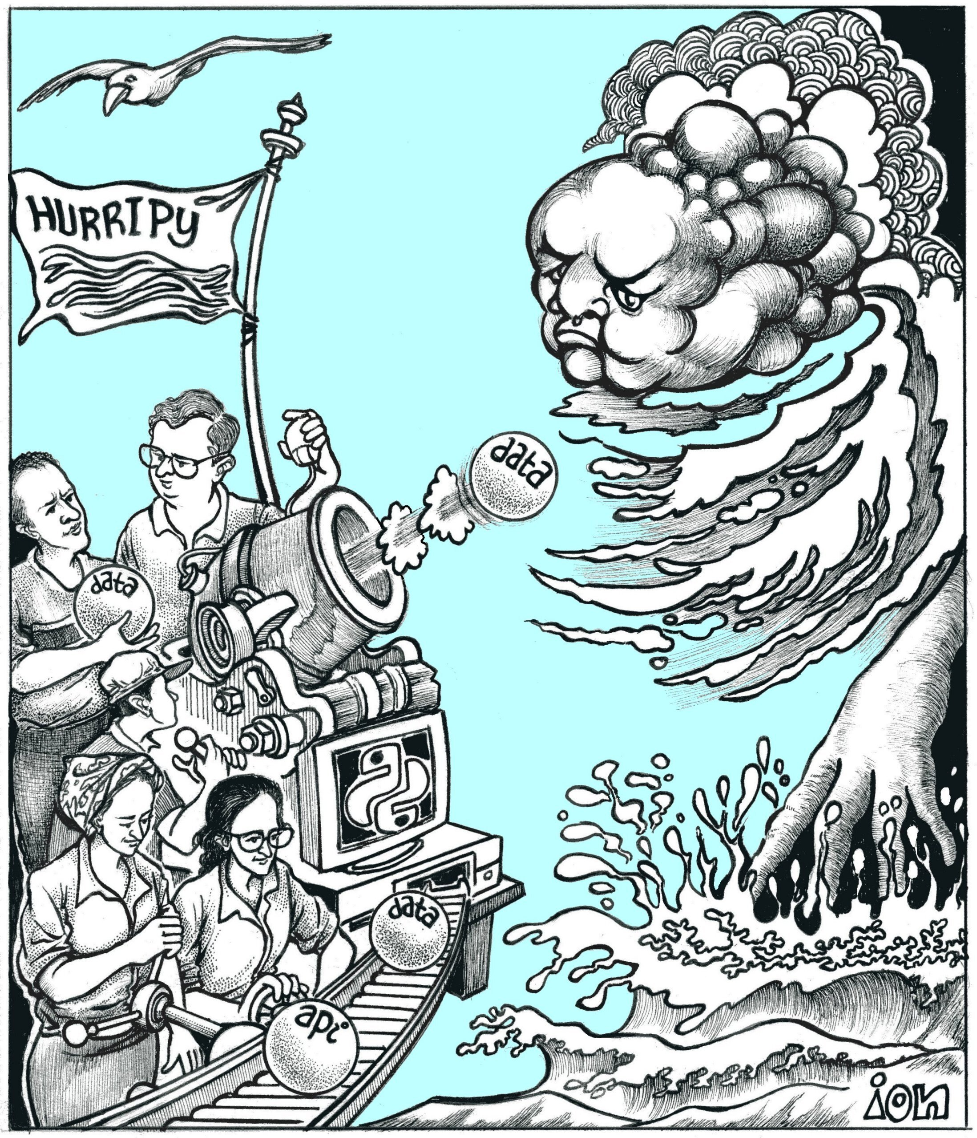
Introduction:
Our questions
Question 1: When Tropical Storm Cristobal formed at the start of this month, it was the earliest we saw a “C” named storm. Is this a trend or just an outlier?
Question 2: What are the demographics of an area before and after a storm?
Question 3: Do hurricanes effect the temperature on land?

Slide 3
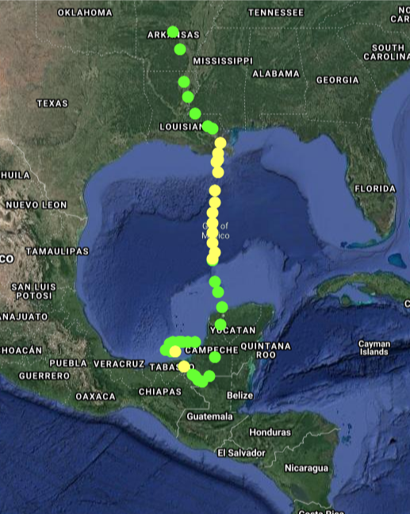
Tracking Cristobal:
The earliest time a “C” named storm has arrived
Came out during a pandemic
Started as a tropical storm in the pacific, then made it’s way to the gulf
Tropical Storm Cristobal
Named on 6/2/2020
Legend
- Tropical Depression
- Tropical Storm

Slide 4

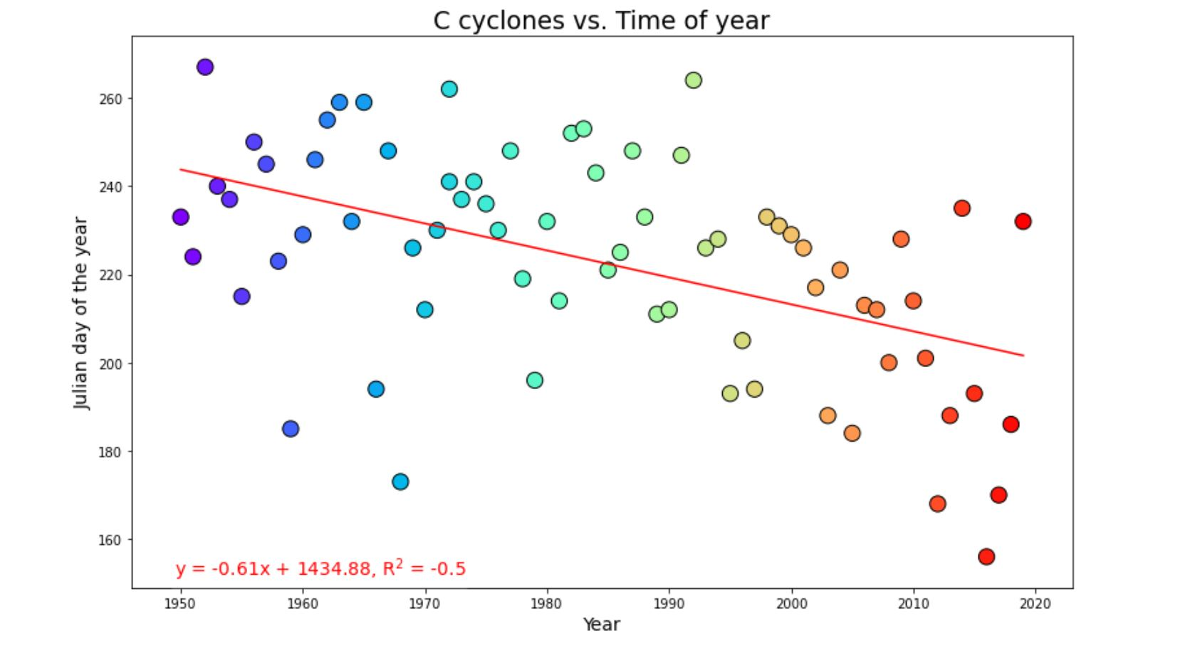
Understanding Cyclones: When do they form?
Cyclones are starting to form earlier in the year.
In 70 years the average season start time has decreased by an entire month.
Hurricanes and Cyclones are caused by warm water temperatures. Our findings have been that due to climate change rising the average ocean temperature, it causes a direct effect in the onset.

Slide 5
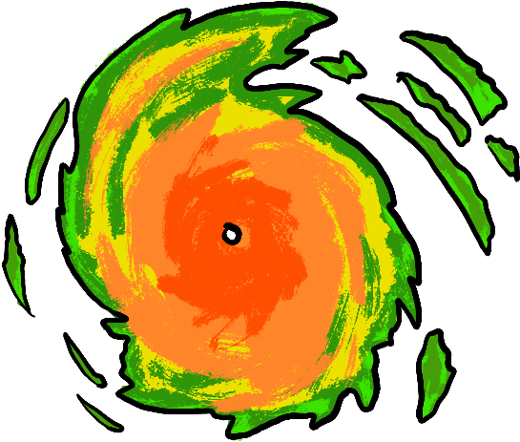
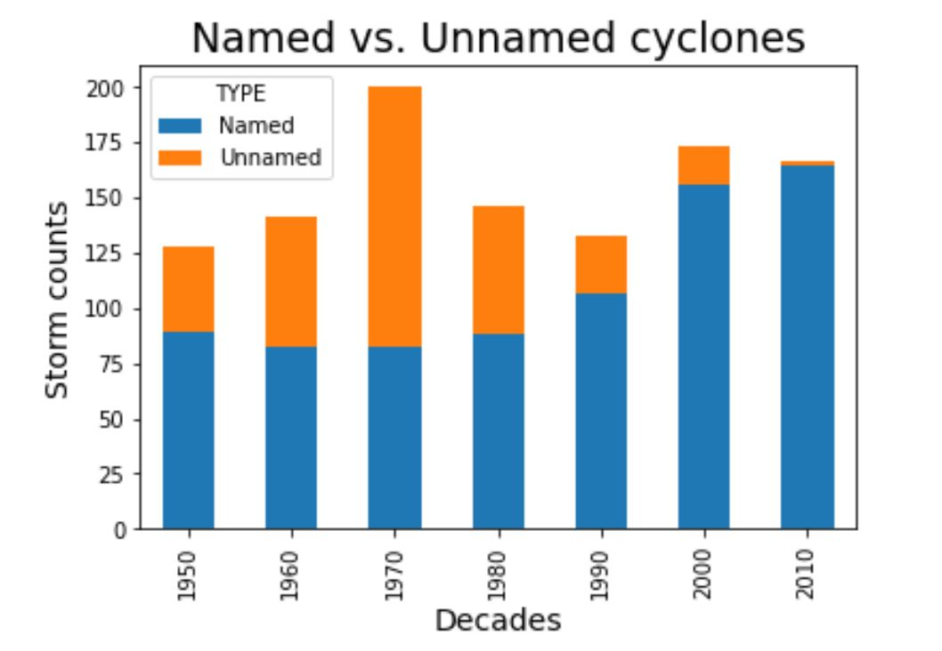
Understanding Cyclones: Names
In 2010, almost all tropical systems became named storms
In 1970s, the overall tropical systems weren’t relatively strong, and hence remained unnamed
Starting 1950s, storm cycles began getting named

Slide 6

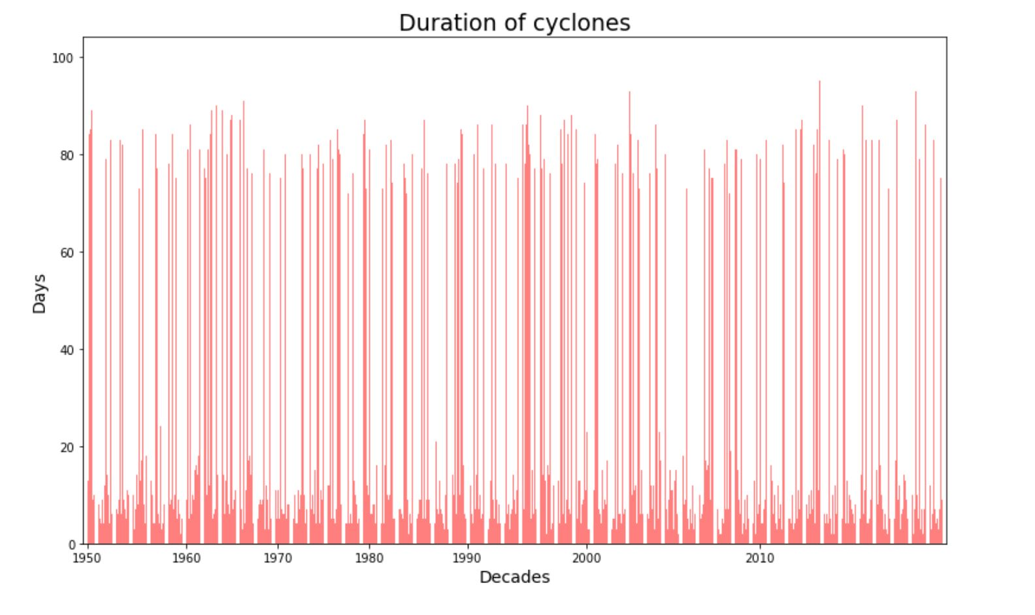
Understanding Cyclones: Duration
Most cyclones last 3-7 days
Some outliers last up to 90 days!!

Slide 7

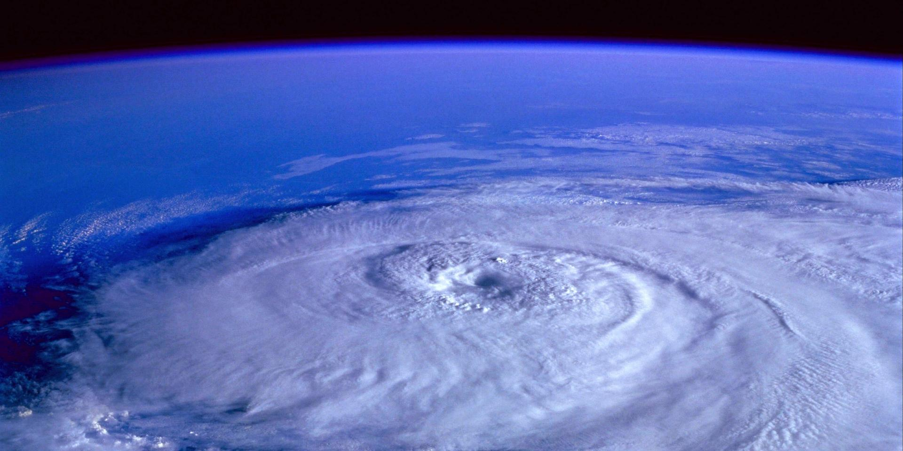
Understanding Cyclones: Conclusion
Tropical systems are forming a month earlier on average over the past 70 years
More tropical systems are getting named
Most tropical systems last 3-7 days, but the outliers last up to 90!!
Notes:
Data exploration: Data was retrieved from the National Hurricane Center's website (https://www.nhc.noaa.gov/data/#hurdat)
Data Cleanup: Data was scrubbed in Excel to assign a unique storm name, type and Julian to each of the 52k rows so we could understand onset and duration of each individual storm.
Data Analysis: The cleaned .csv data was imported into Jupyter Notebooks as Pandas DataFrames. Certain data types were converted from float to integer. Bob and Kevin shared a new approach on setting tick locations for the bar graph. We used:
dropna to omit NaN data
drop to filter DataFrames,
groupby to cluster data by cyclone type and the corresponding decade
Data Visualization: A stacked bar graph to understand the split between named vs. unnamed cyclones since 1950
A bar graph to plot the duration of named cyclones with the decades as tick location markers
A scatter plot to plot the cyclone patterns by decade and their corresponding onset in terms of time of the year. We also calculated the regression between onset and years.

Slide 8

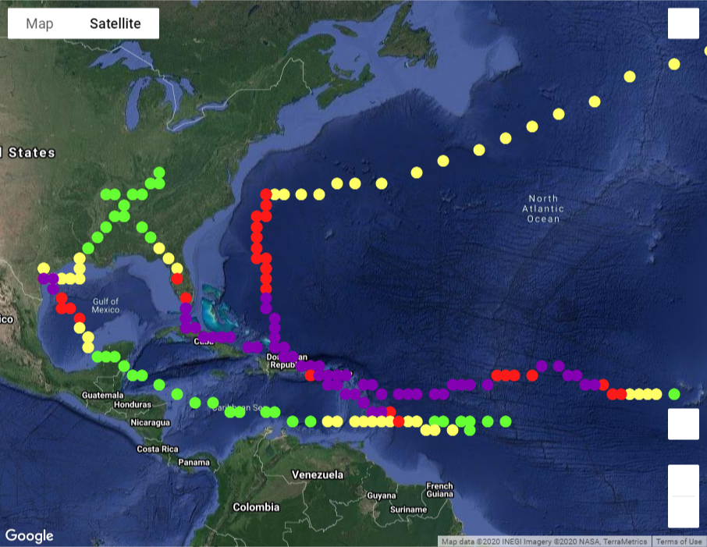
Tracking: Harvey, Irma, and Maria
2017 Focus Storms
Hurricane Harvey (Aug 17 – Sept 7)
Hurricane Irma (Aug 30 – Sept 12)
Hurricane Maria (Sept 16 – Oct 2)
Legend
- Tropical Depression
- Tropical Storm
- Minor Hurricane (Cat 1 and 2)
- Major Hurricane (Cat 3, 4, and 5)
Hurricane Irma
Hurricane Maria
Hurricane Harvey

Slide 9

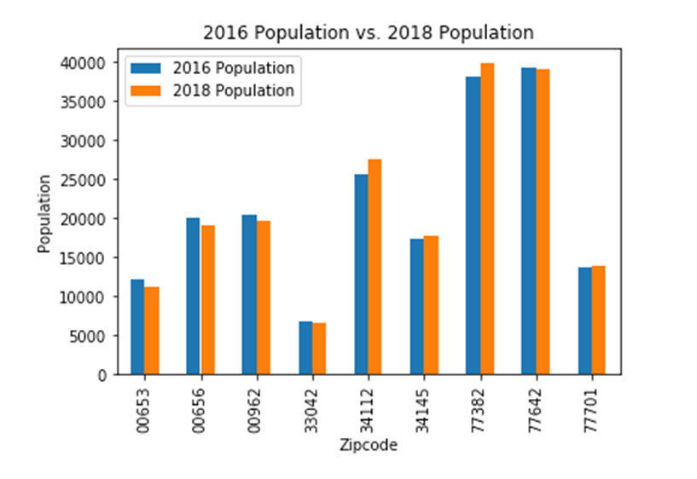
Demographics: Population
After some hurricanes, the population increased in certain areas while it slightly decreased in other areas
Population does not appear to have a strong correlation with hurricanes

Slide 10

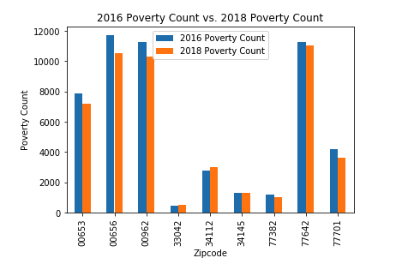
Demographics: Poverty
Hurricane Maria had a huge impact on the population in Puerto Rico, hence potential loss of life could reflect an overall poverty decrease
Poverty does not appear to have a strong correlation with hurricanes

Slide 11

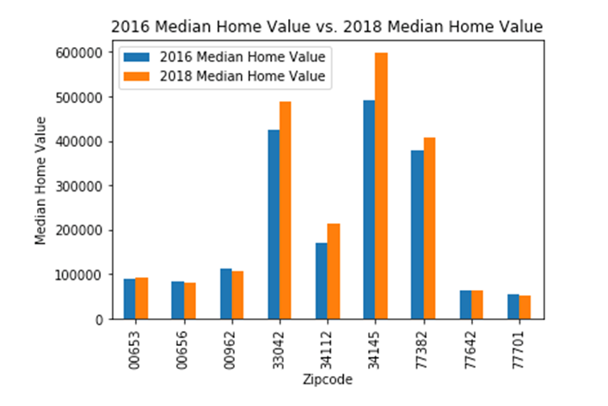
Demographics: Median Home Value
This was our most surprising find!
Hurricanes do not have a negative effect on home value as perceived
Median home value does not appear to have a strong correlation with hurricanes

Slide 12
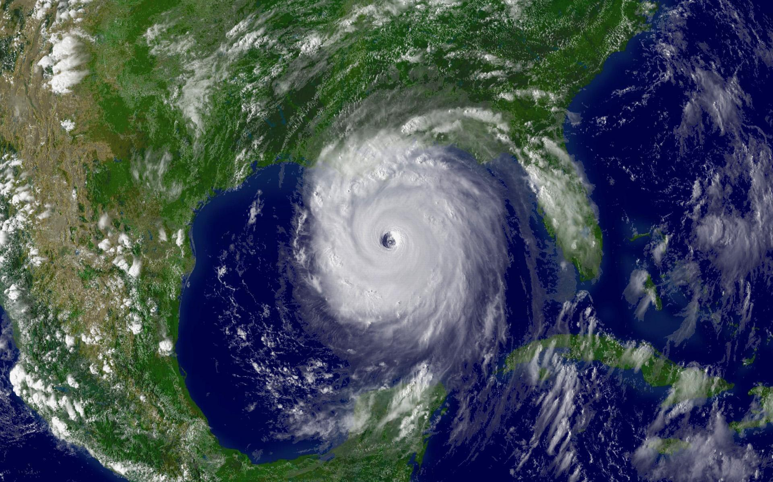
Demographics: Conclusion
Poverty, Population, and Median home value do not appear to have a strong correlation with hurricanes
Notes:
Data exploration: Data was retrieved using Census API for population, poverty count, and median home value for three zip codes per cyclone.
Data Cleanup: Retrieved data in 2018 that was NaN and that data was dropped using drop.na. 2016 and 2018 DataFrames were merged to create a new data frame.
Data Analysis/Data Visualization: Bar graphs were used to analyze the comparison of 2016 and 2018 demographics to see if cyclones impacted population, poverty count, and median home value.

Slide 13


Question #3:
We know that hurricanes cool ocean water, but do they cool the land where they make landfall?
We know that storms cool water temperatures 4 degrees on average.
Not much data and research has been done to measure the cooling effects storms have on landfall.
We used an API from NOAA (National Oceanic and Atmospheric Administration) to answer our question.

Slide 14



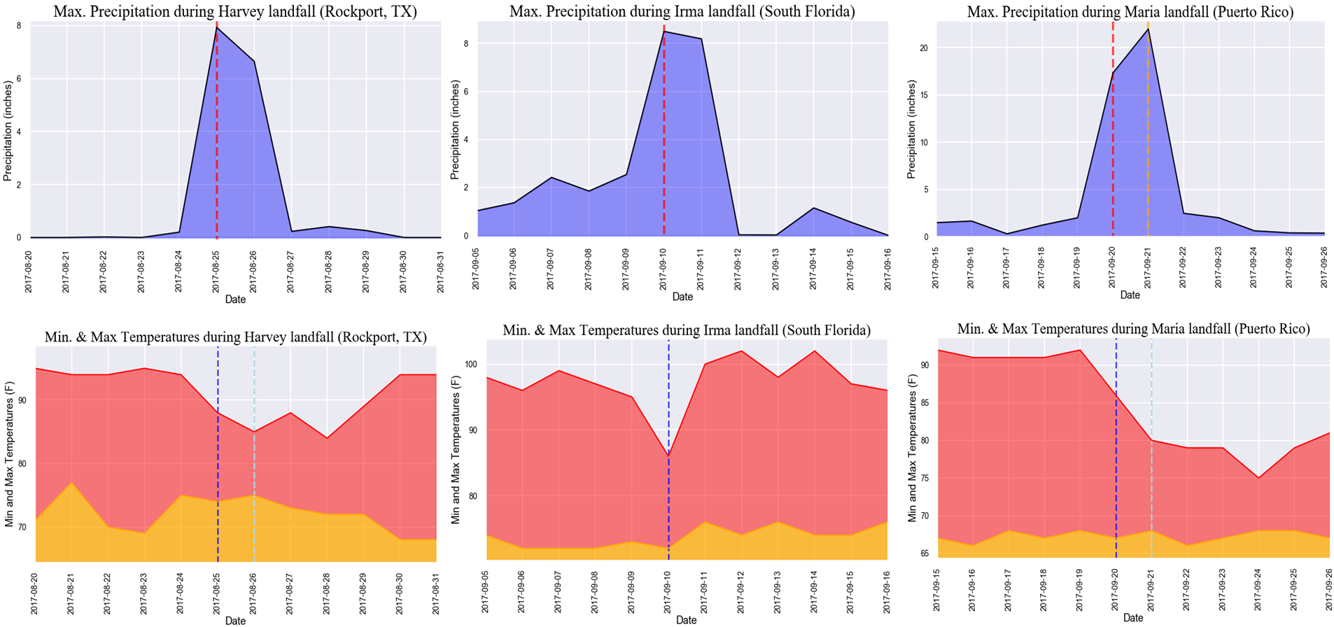
Each hurricane is accompanied by a spike in precipitation (blue) in the landfall areas.
Correspondingly, the maximum air temperature (shown in red) dropped when a hurricane made a landfall.
Minimum air temperature (shown in yellow) increased for Harvey and Irma but remained unchanged for Maria.
Maximum temperature rebounded fastest in the South Florida coast (Hurricane Irma) and remained low in Puerto Rico (Hurricane Maria) for the longest time. This is probably an indication how long hurricane clouds lingered over the landmass.

Slide 15
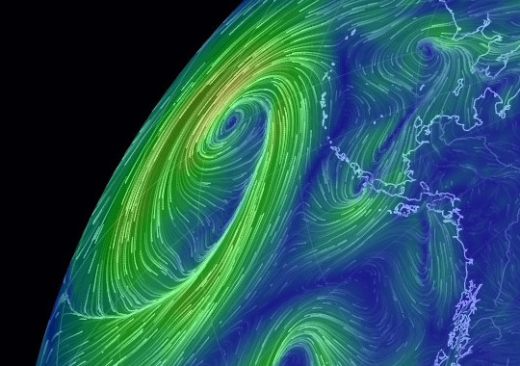
Storms and Land Temperature: Conclusion
Our study found that hurricanes have a “cooling effect” on earth.
Mother Nature’s method of managing heat imbalance in oceans is creating hurricanes – a giant blender that mixes the hot air at the center with the dry colder air at the top of the troposphere.
Our conclusion is: “Along with cooling the oceans, hurricanes cool the landmass where they make landfall.”
Notes:
Data exploration: Data was retrieved using NOAA API for weather stations in the landfall area of each hurricane
Data Cleanup: Retrieved data had "SNOW" column, which indicates snow precipitation measured in that weather station. That column was discarded from the dataset.
Data Analysis: The maximum and minimum temperatures, precipitation from every station were grouped according to the dates - 5 days before and 6 days after the landfall.
Data Visualization: Line plots were made for precipitation, maximum and minimum temperatures were built to see the changes in those parameters during hurricane landfall.

Slide 16

Resources:
Data sets used:
https://www.census.gov/
https://www.nhc.noaa.gov/
https://www.weather.gov/
flhurricane.com
We attempted to scour buoy data from https://www.ndbc.noaa.gov/ but had no luck :’(
API keys requested from:
Census
Google maps
NOAA

Slide 17

Special thanks to Bob!
ALL HAIL THE KING!

Slide 18

Any Questions?

